Slide 1
MODULES DESCRIPTION
1.Model building
2. Streamlit UI
3. Data preparation
4.Model Training

Slide 2
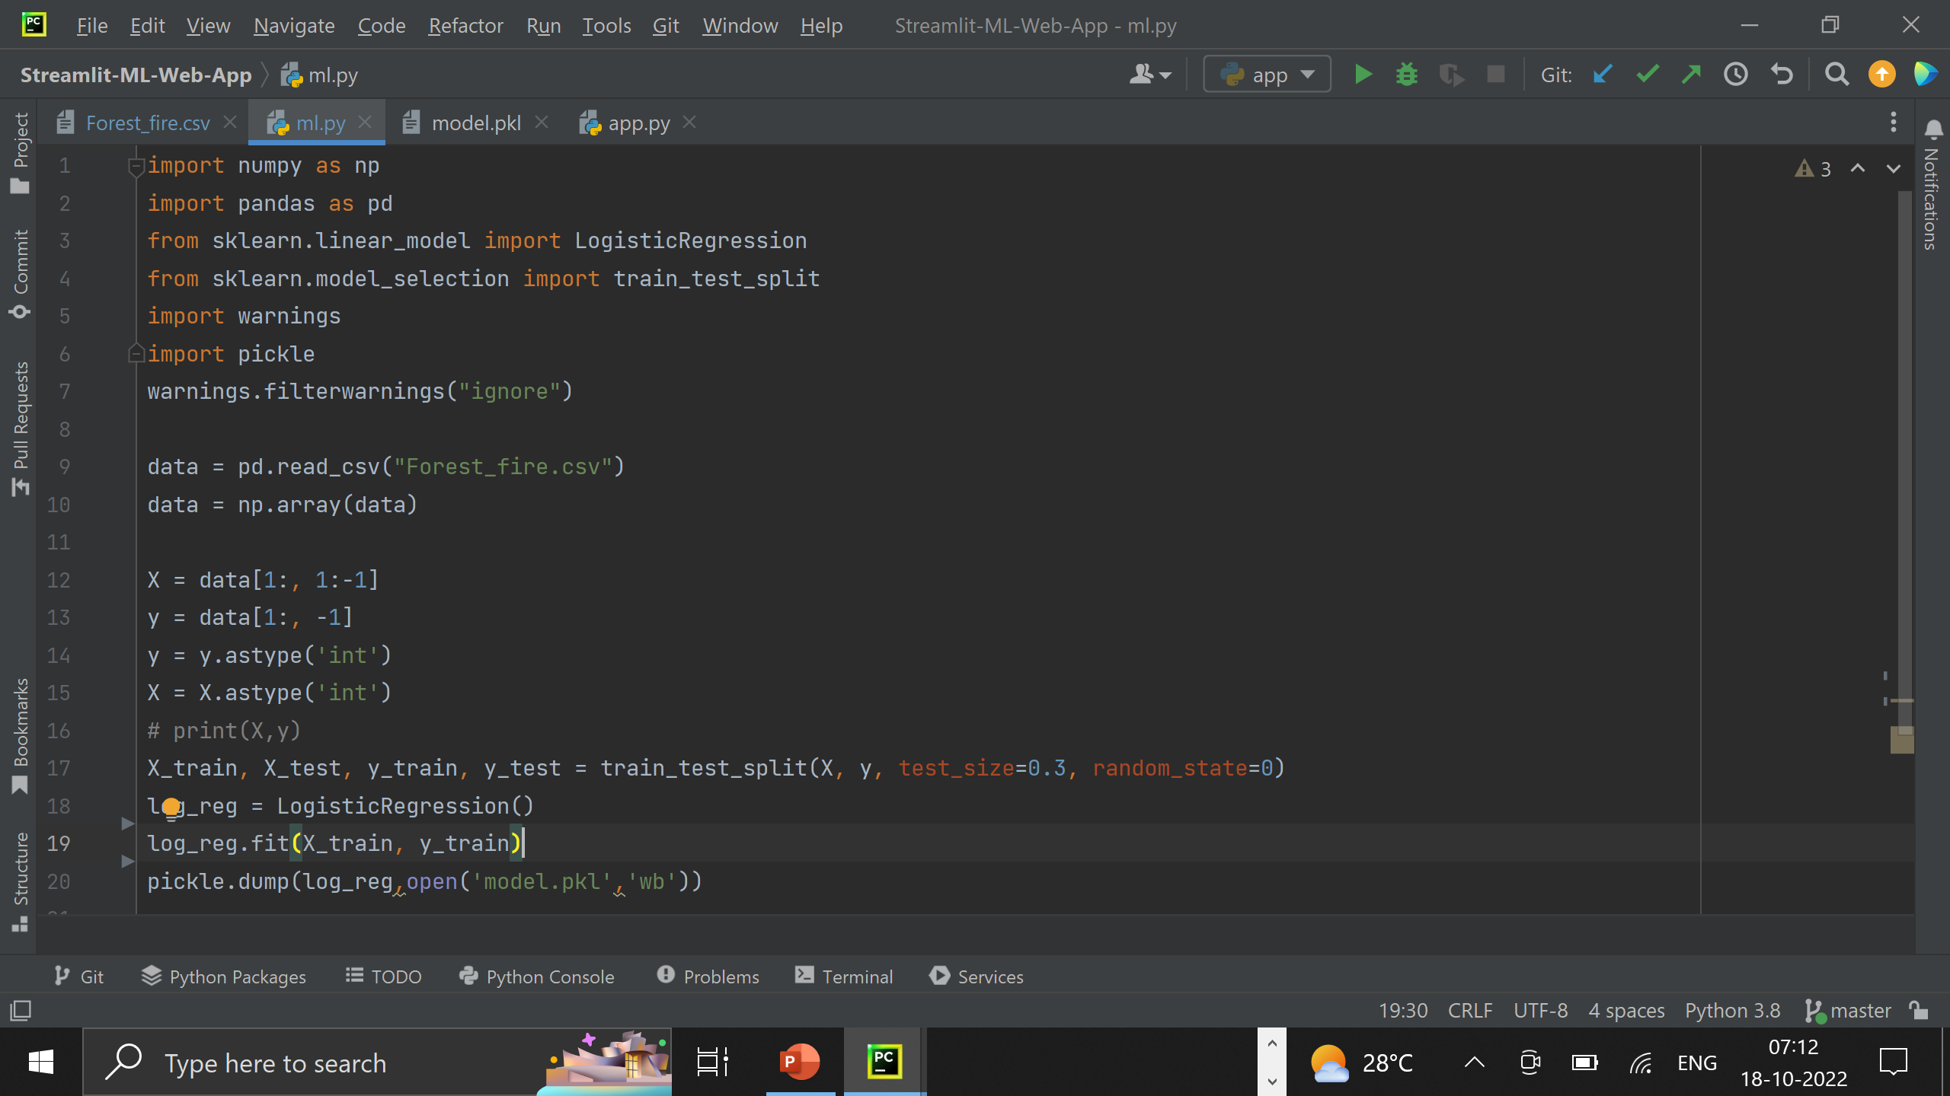

Slide 3
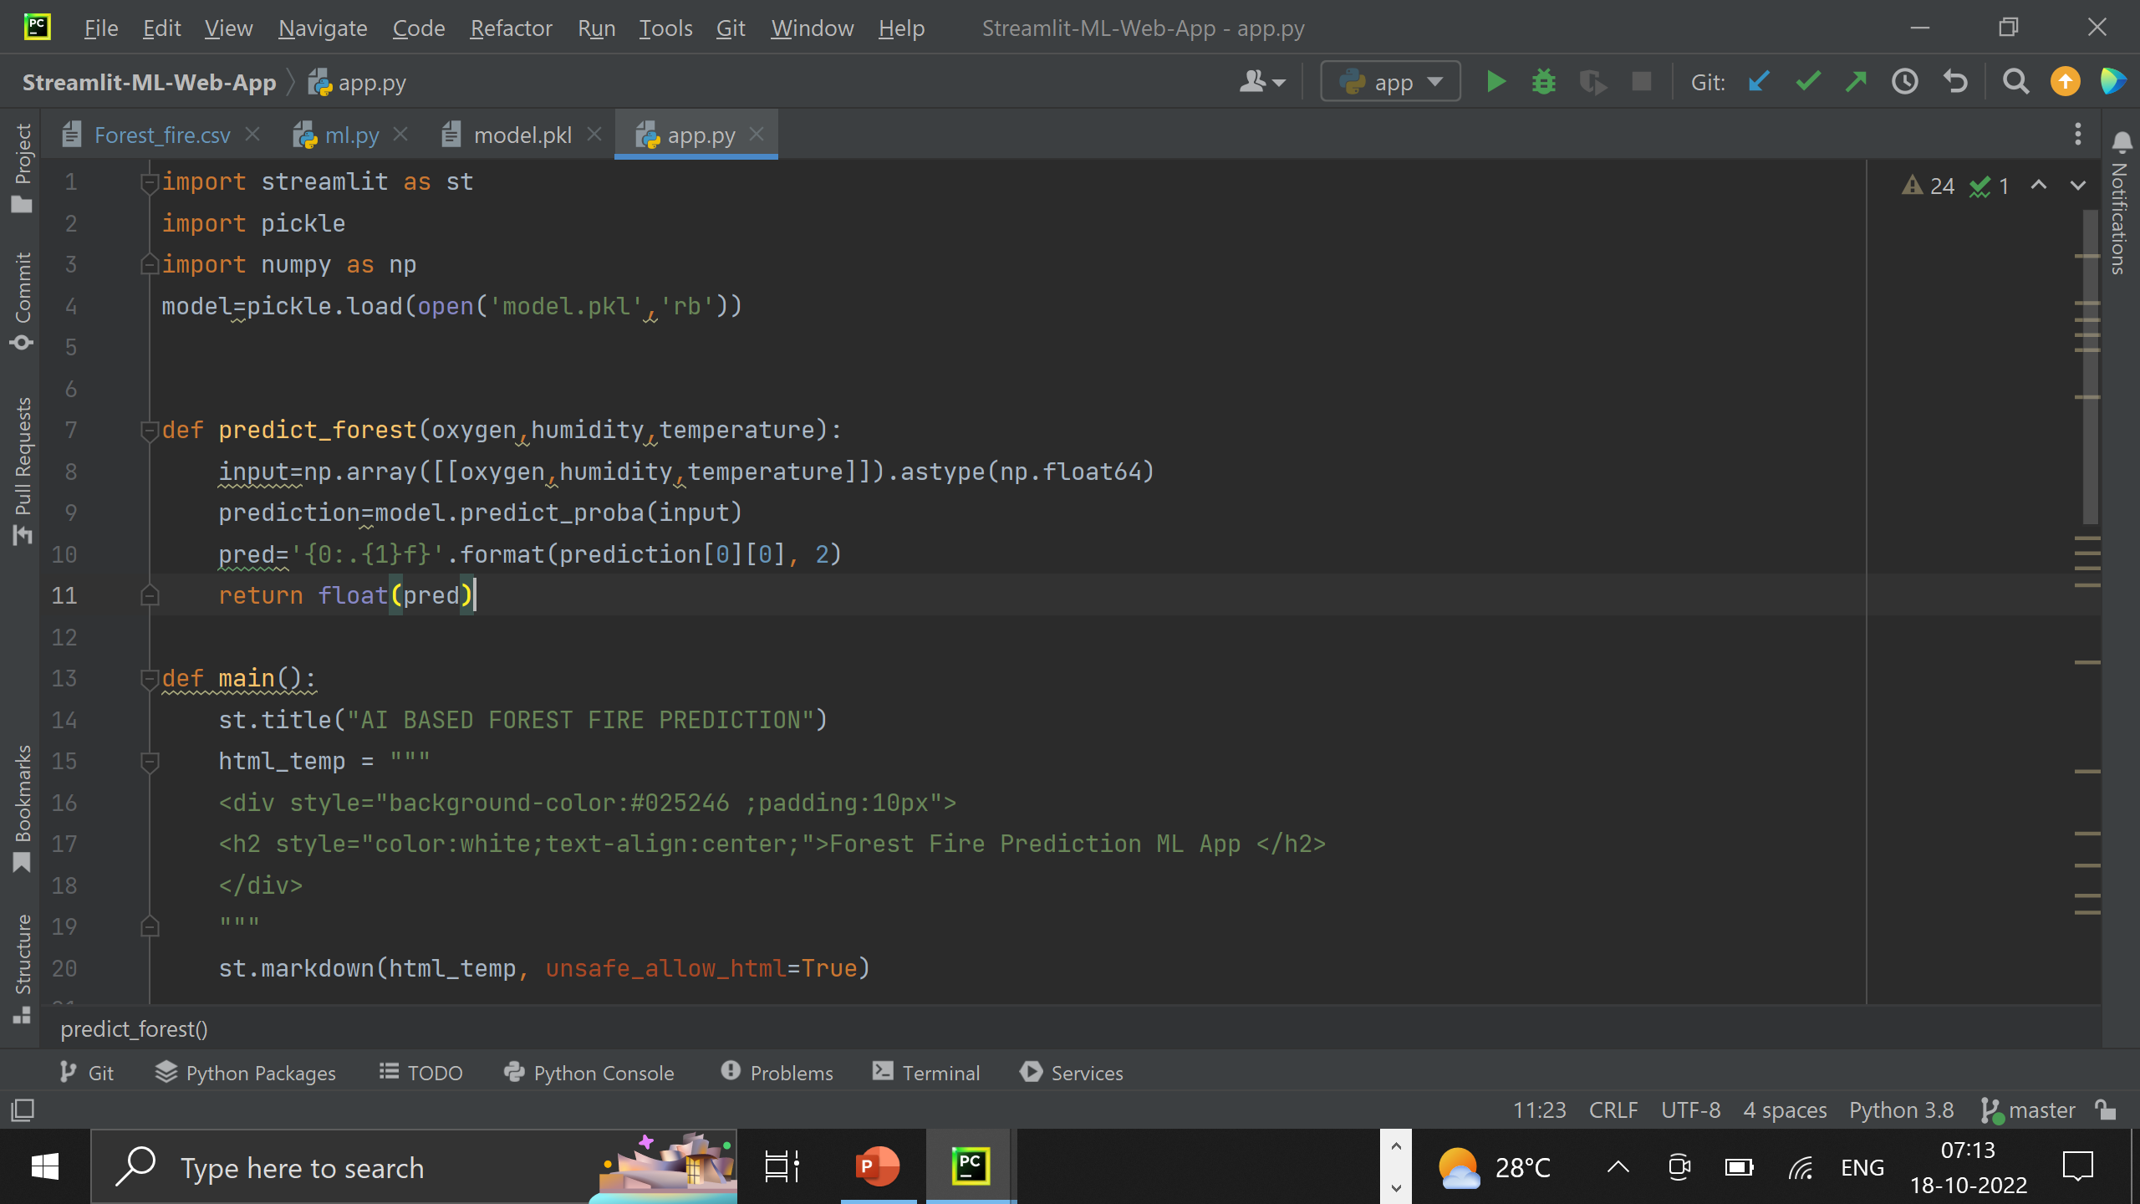

Slide 4
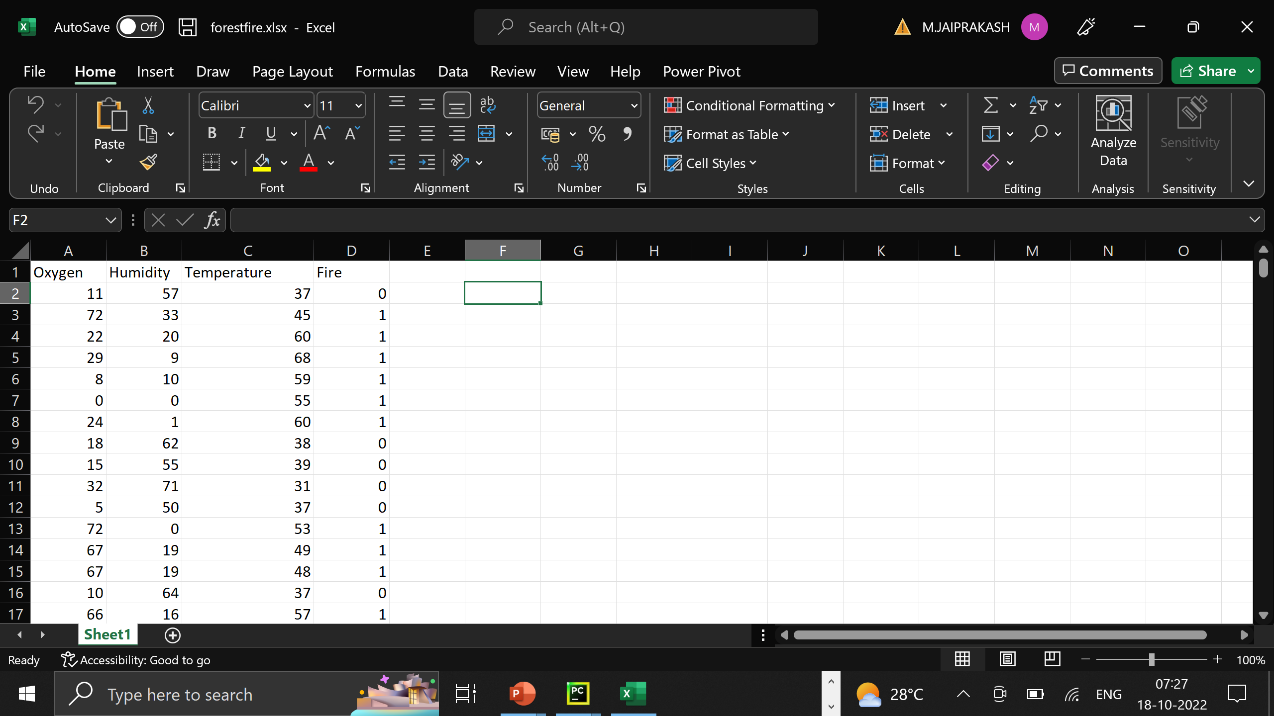

Slide 5
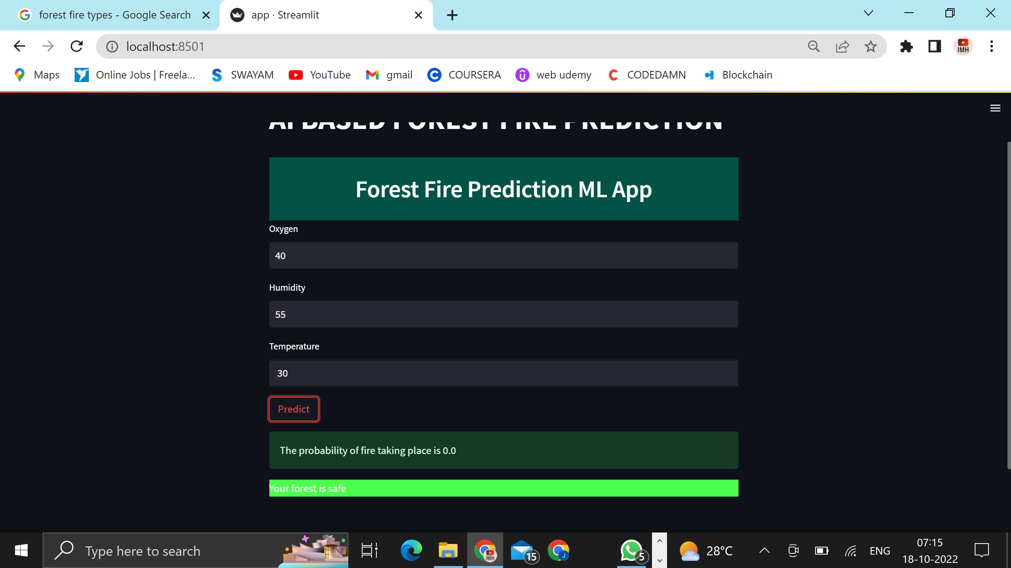

Slide 6
